Slide 1
All workshop material is available at github:
https://github.com/cdoorenweerd/20180809_UH_Python_workshop
Notes:
If you have any questions, feel free to ask

Slide 2
Morning session
Python in the grand scheme of things
Python vs R
Introduction to Python
Break
Coding with style
Useful packages: Anaconda, Pandas, Matplotlib etc.
User case: biopython
Maybe: Github/readthedocs
Lunch 12pm – 1pm
Afternoon
Jupyter notebook
Plot your own distribution maps!
Notes:
Take home message: Even with low skill level you can produce useful things.

Slide 3
Test your own competence:
http://sijinjoseph.com/programmer-competency-matrix/
Notes:
Who has experience with Python? Who with R? I’m Camiel.
I did my PhD at the university of Amsterdam and the Natural History Museum. Bioinformatics is a new field that most permanent contracted researchers were not trained in.

Slide 4
Notes:
Where do you start when you have decided you want to learn some programming language?
Why would you use scripting?
automation of repeated tasks
software you need may not exist
handling of large data
statistics
graphs
maps
websites

Slide 6
Codeeval.com

Slide 7
Notes:
Python is easy to learn!

Slide 9
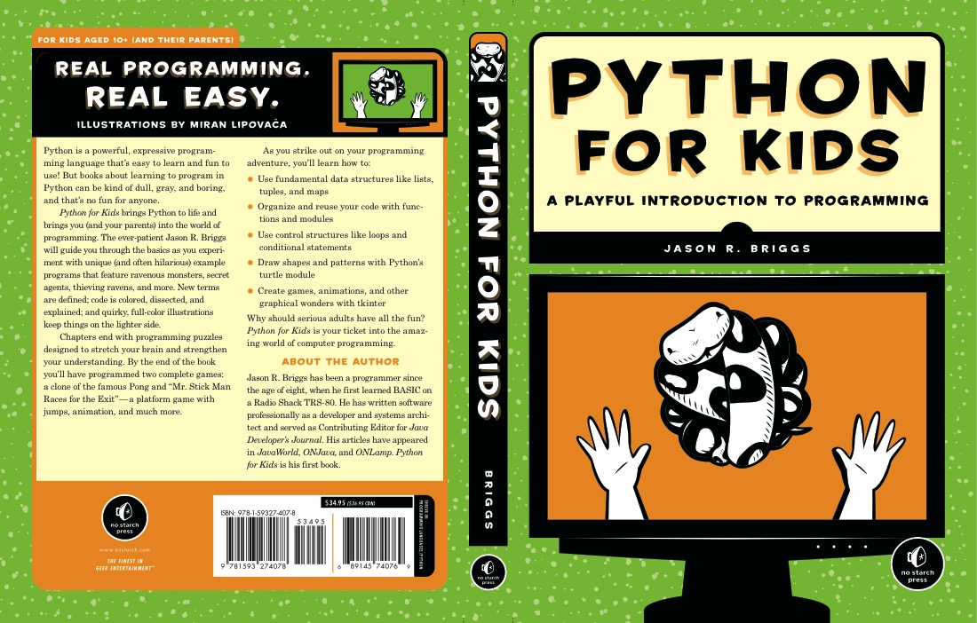
Notes:
Let’s try something.

Slide 10
Open a terminal
Type: python
print(”Hello World”)
10*36+8
Assigning variables:
Priscilla = 30 [equivalent in R: Priscilla <- 30]
Brad = 25
Priscilla*Brad
Try a for loop:
Camiel = [3,6,8,2,298]
For number in Camiel:
print(number)
Notes:
There are different ways to interact with python; interactively in terminal, through scripts, or though jupyter notebook. Simple basic commands, like legos, but you could use them to build a death star.

Slide 12
“Code is read much more often than it is written” – Guido van Rossum
“Name your variables with ❤️ ” – Uncle Bob
➔ Python Enhancement Protocol (PEP) style guide to coding

Slide 13
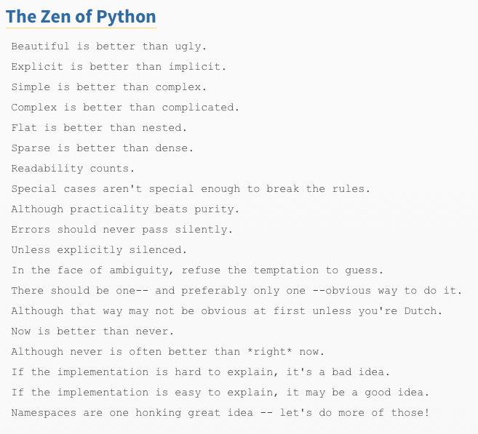
https://www.python.org/dev/peps/pep-0008/
Notes:
There are different ways to interact with python; interactively in terminal, through scripts, or though jupyter notebook

Slide 14
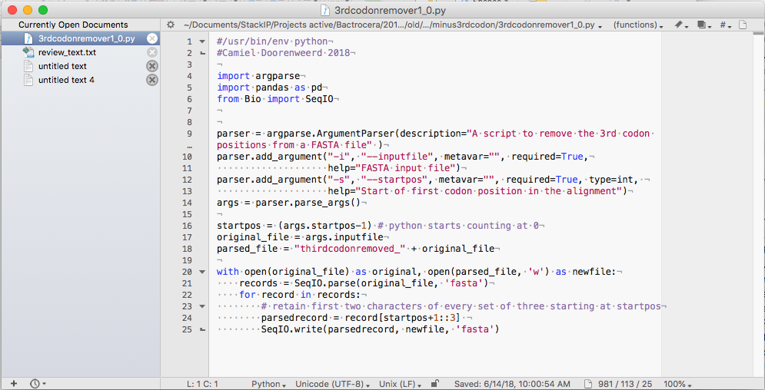
geany
BBEdit
TextWrangler
Notes:
Good (free) text editors: Textwrangler, BBEdit, Geany

Slide 16
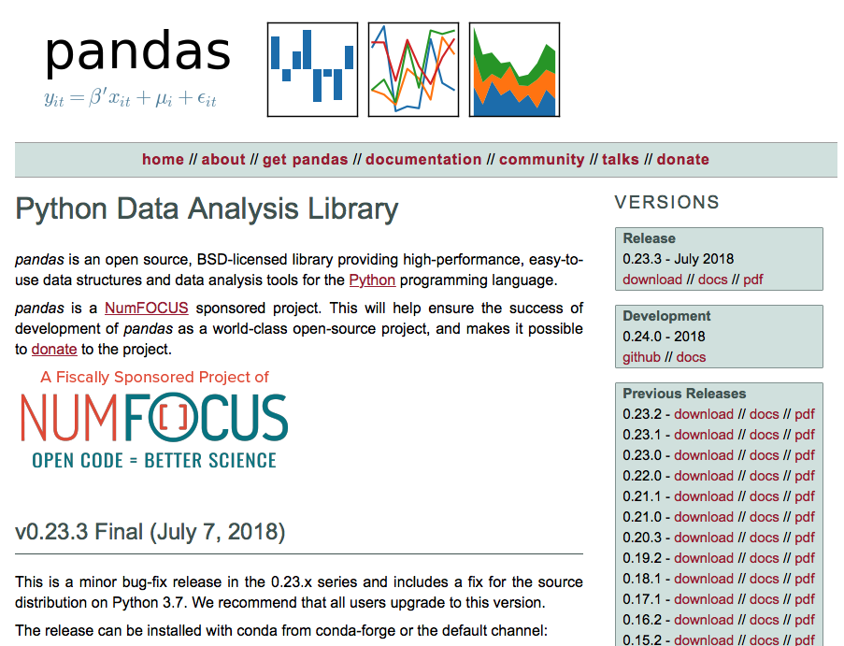
Notes:
Pandas is the go-to statistics package. Includes dataframes (spreadsheets). Many tutorials available as youtube videos or blogs or whatever.

Slide 17
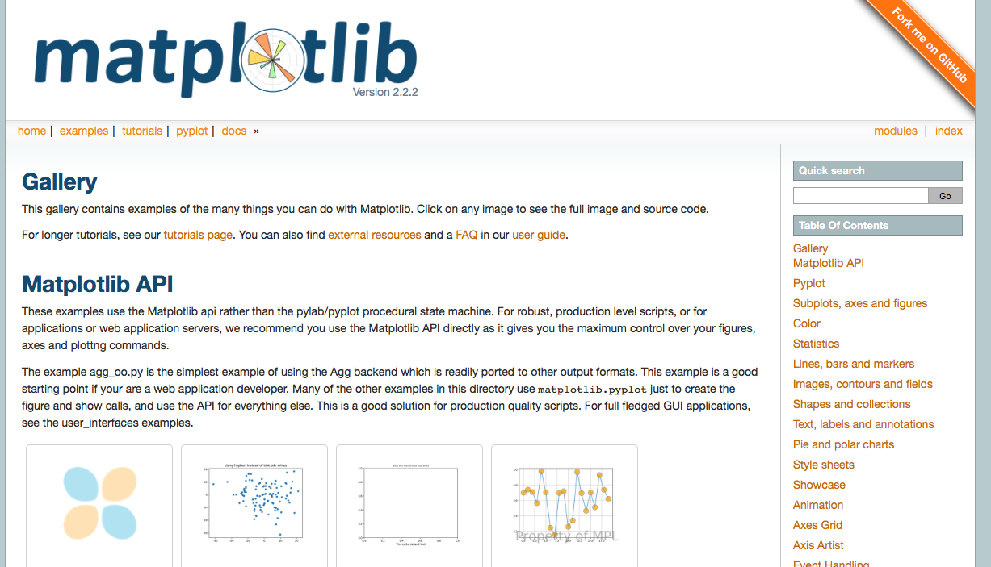
Notes:
For plotting data. We will be using matplotlib libraries in the afternoon.

Slide 18
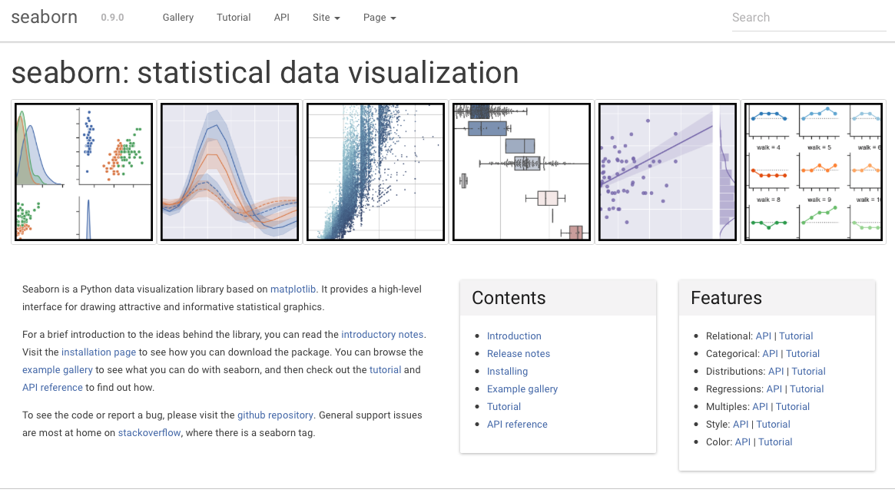
Notes:
If you want your graphs to look like ggplot in R, or even better.

Slide 19
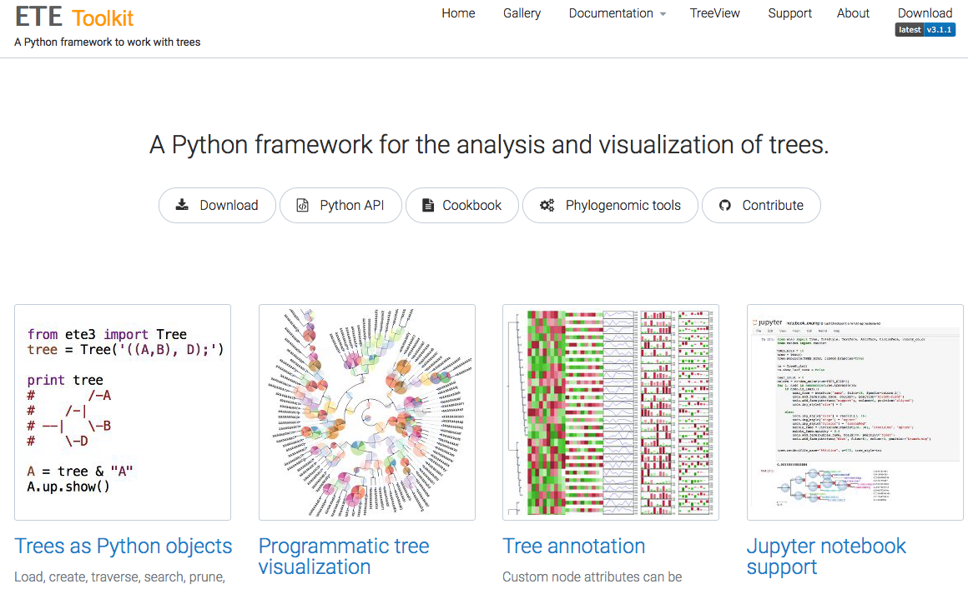

Slide 20
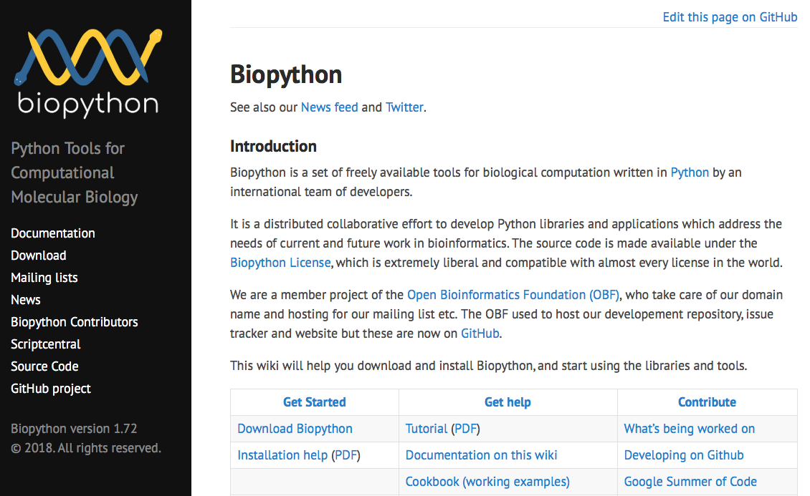
Notes:
Let’s try a biopython example.

Slide 21
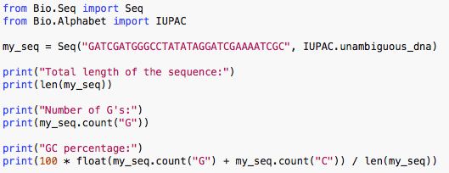
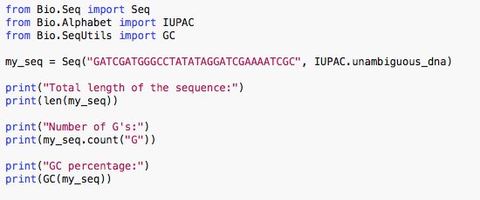
While you could use the above snippet of code to calculate a GC%, note that the Bio.SeqUtils module has several GC functions already built. For example:
Notes:
Let’s write up a script that counts the GC% of a sequence and run it!

Slide 23
lunch

Slide 24
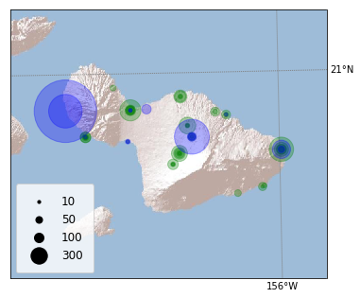
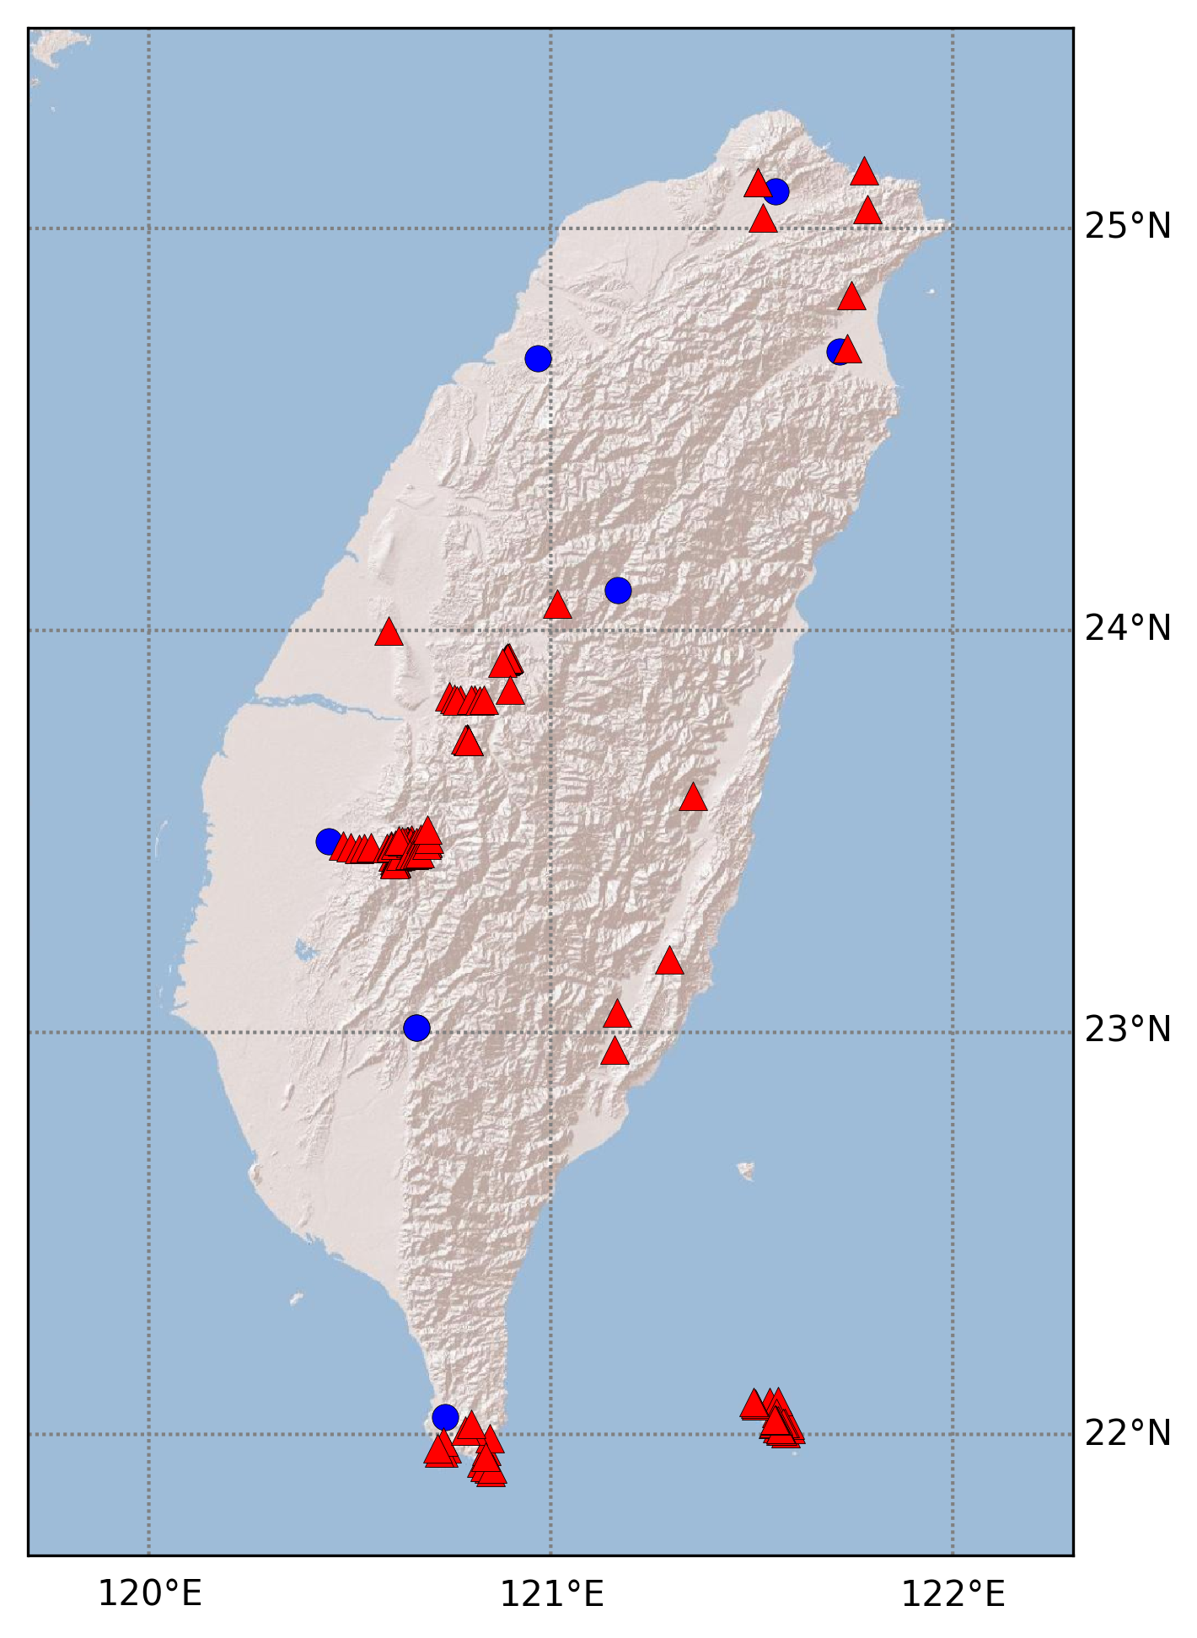
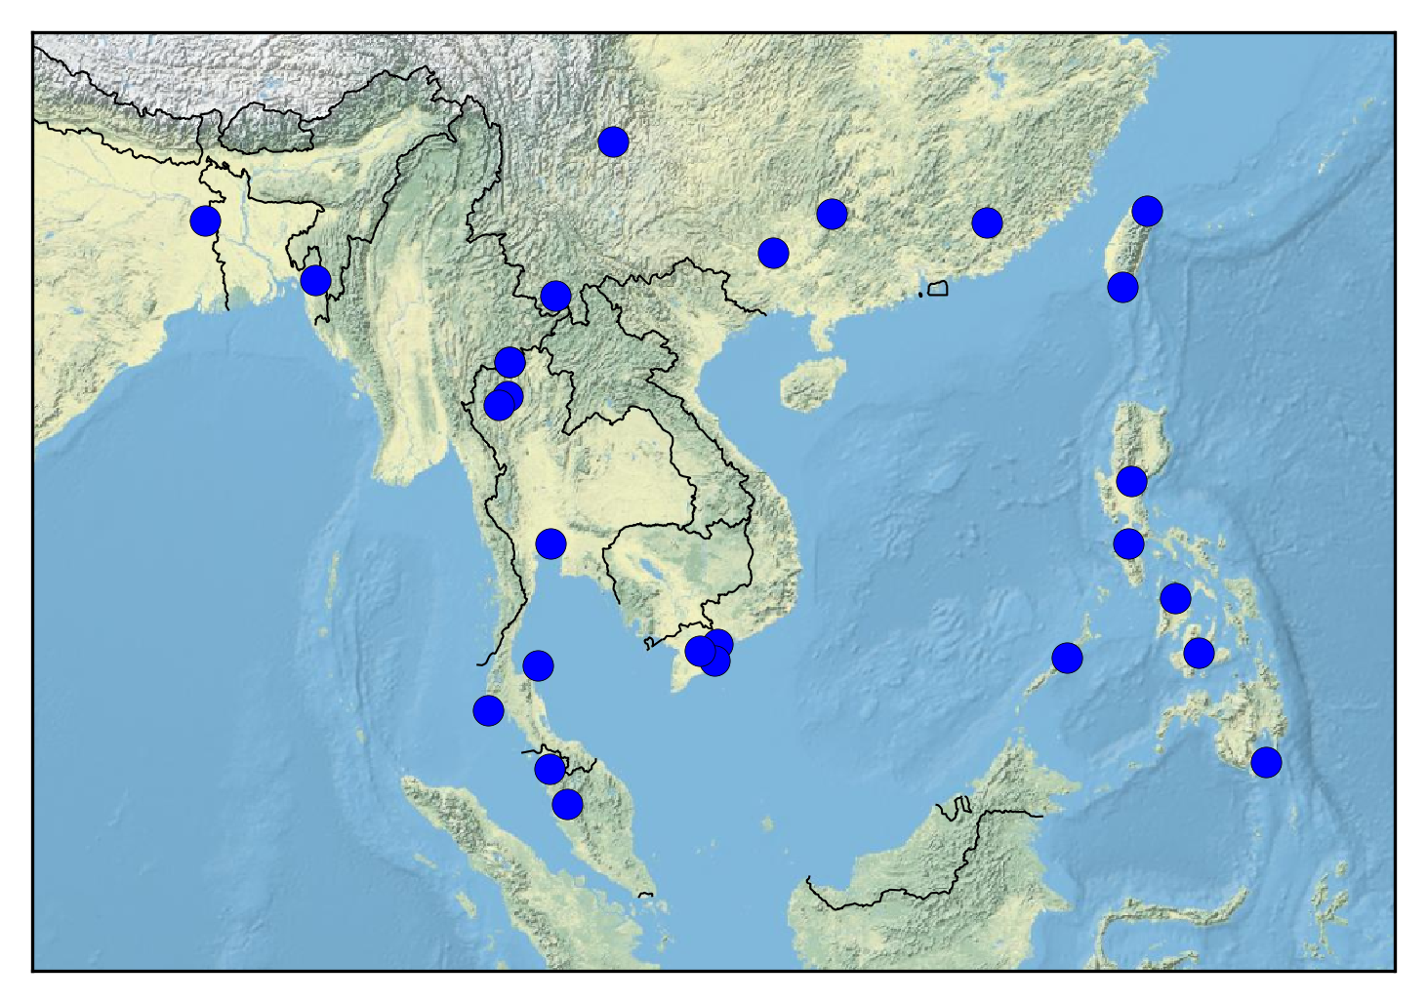
Notes:
Afternoon session! Let’s make some distribution maps using the matplotlib library

Slide 25
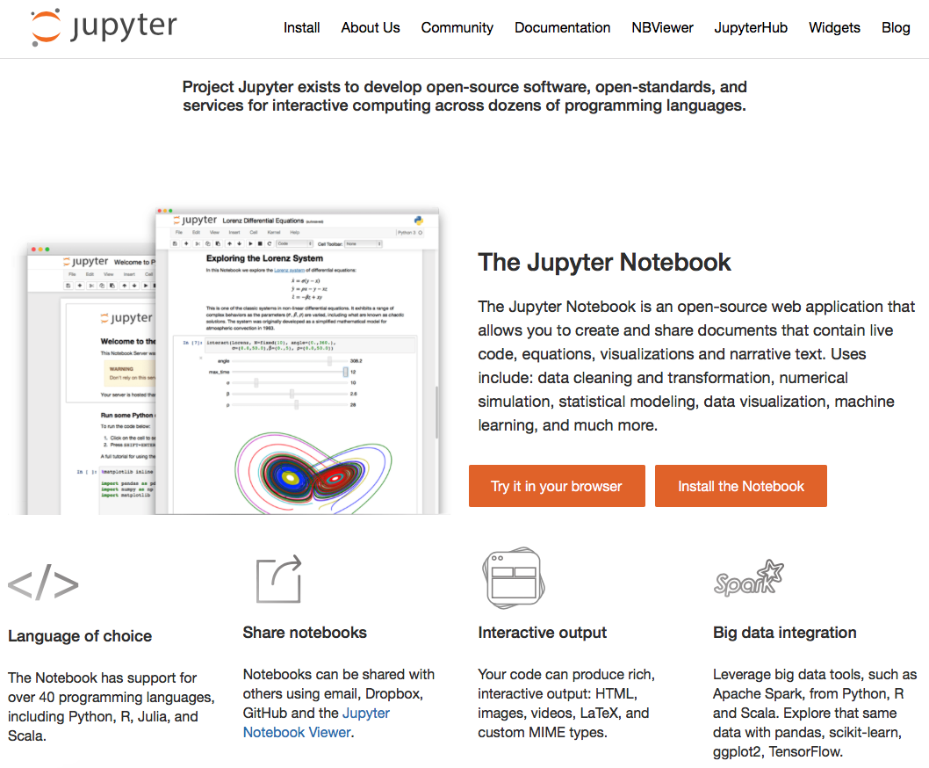
Notes:
Afternoon session: jupyter notebook. Rstudio equivalent. But can also run R.

